Slide 1
AHC - Academy

Slide 2
SQL Fundamentals
Create, Read, Update, Delete. Constrains and Joins

Slide 3
Constrains
SQL constraints are used to specify rules for data in a table.
Constraints can be specified when the table is created with the CREATE TABLE statement, or after the table is created with the ALTER TABLE statement.
Syntax:
CREATE TABLE table_name ( column1 datatype constraint, column2 datatype constraint, column3 datatype constraint, .... );

Slide 4
Constrains commonly used
NOT NULL - Ensures that a column cannot have a NULL value
UNIQUE - Ensures that all values in a column are different
PRIMARY KEY - A combination of a NOT NULL and UNIQUE. Uniquely identifies each row in a table
FOREIGN KEY - Prevents actions that would destroy links between tables
CHECK - Ensures that the values in a column satisfies a specific condition
DEFAULT - Sets a default value for a column if no value is specified
CREATE INDEX - Used to create and retrieve data from the database very quickly

Slide 5
Demo
Constrains

Slide 6
Exercise
Constrains
Create a unique constrain for Place.Name

Slide 7
Create (Insert)
The INSERT INTO statement is used to insert new records in a table.
Syntax:
INSERT INTO table_name (column1, column2, column3, ...) VALUES (value1, value2, value3, ...);

Slide 8
Demo
Create (Insert)

Slide 9
Exercise
Create (Insert)
Insert User info
Insert Place info
Insert Event info
Insert Sales info

Slide 10
Read (Select)
The SELECT statement is used to select data from a database.
Syntax:
Specific columns:
SELECT column1, column2, ... FROM table_name;
All columns:
SELECT * FROM table_name;

Slide 11
SQL Joins
The JOIN clause is used to combine rows from two or more tables, based on a related column between them.
Here are the different types of the JOINs in SQL:
(INNER) JOIN: Returns records that have matching values in both tables
LEFT (OUTER) JOIN: Returns all records from the left table, and the matched records from the right table
RIGHT (OUTER) JOIN: Returns all records from the right table, and the matched records from the left table
FULL (OUTER) JOIN: Returns all records when there is a match in either left or right table

Slide 12
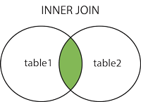
SQL Joins | INNER JOIN
The INNER JOIN keyword selects records that have matching values in both tables.
Syntax:
SELECT column_name(s) FROM table1 INNER JOIN table2 ON table1.column_name = table2.column_name;

Slide 13
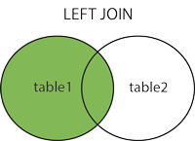
SQL Joins | LEFT (OUTER) JOIN
The LEFT JOIN keyword returns all records from the left table (table1), and the matching records from the right table (table2). The result is 0 records from the right side, if there is no match.
Syntax:
SELECT column_name(s) FROM table1 LEFT JOIN table2 ON table1.column_name = table2.column_name;

Slide 14
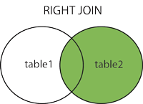
SQL Joins | RIGHT (OUTER) JOIN
The RIGHT JOIN keyword returns all records from the right table (table2), and the matching records from the left table (table1). The result is 0 records from the left side, if there is no match.
Syntax:
SELECT column_name(s) FROM table1 RIGHT JOIN table2 ON table1.column_name = table2.column_name;

Slide 15
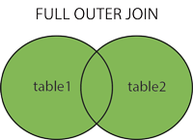
SQL Joins | FULL (OUTER) JOIN
The FULL JOIN keyword returns all records when there is a match in left (table1) or right (table2) table records. Syntax:
SELECT column_name(s) FROM table1 FULL OUTER JOIN table2 ON table1.column_name = table2.column_name WHERE condition;

Slide 16
Demo
Read (Select)

Slide 17
Exercise
Read (Select)
Get the events by users.

Slide 18
Update
The UPDATE statement is used to modify the existing records in a table.
Syntax:
UPDATE table_name SET column1 = value1, column2 = value2, ... WHERE condition;

Slide 19
Demo
Update

Slide 20
Exercise
Update
Update one or two columns of each table and at least one record.

Slide 21
Delete
The DELETE statement is used to delete existing records in a table.
Syntax:
DELETE FROM table_name WHERE condition;

Slide 22
Demo
Delete

Slide 23
Exercise
Delete
Delete one record of any table that you want (you need to care of table constrains).

